Slide 1
An Example of Difficult Conversations: Climate Change Mitigation and Adaptation
Eugene S. Takle
Professor
Department of Agronomy
Department of Geological and Atmospheric Science
Director, Climate Science Program
Iowa State University
Ames, IA 50011
2013 North Central CARET/AHS Meeting
Des Moines, Iowa
14-16 July 2013

Slide 2
Characteristics of Controversial Public Issues: Example of Climate Change
Context - History & culture: Technological advances
Multiple stakeholders: Humans, animals, ecosystems
Multiple values, views and interests: Profit, human rights
High stakes with unknown outcomes: Creating unmanageable weather events, global scale
High emotions: Partial information on both sides
Relationships & trust between parties: Conflicts at all levels
Different levels of power: Legislative vs private sector
Different levels of understanding: Evolving science
Decisions have widespread consequences: Civilizations threatened
Adapted from Janet Ayres

Slide 3
Conveying the science in difficult conversations (what I have learned)
Be consistent
Be precise
Avoid misleading or narrowly defined terms (greenhouse gases, model bias, positive feedback)

Slide 4
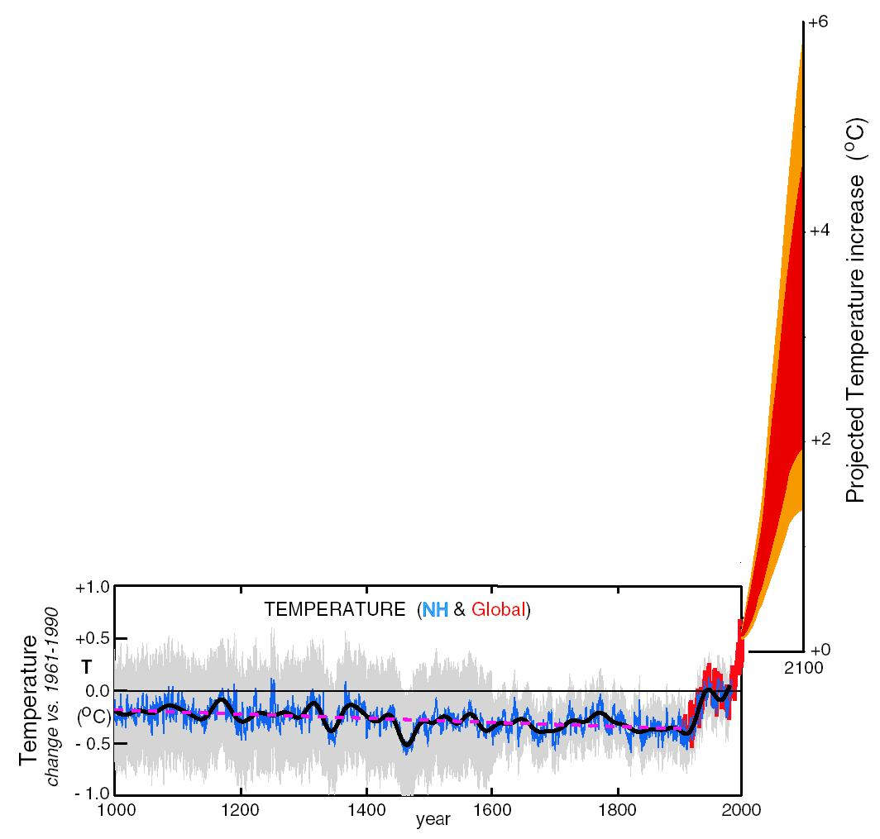
Conveying the science in difficult conversations (what I have learned)
Convey what you don’t know (let the science evolve with consistent support for key messages)
Quantify and report uncertainty
Cultivate trust and respect

Slide 5
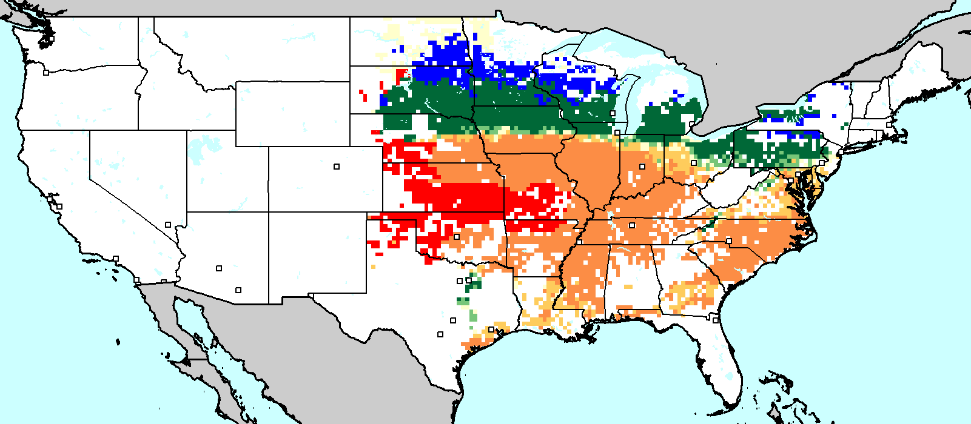
Conveying the science in difficult conversations (what I have learned)
Identify authoritative sources (Ex: NAS on global cooling)
Educate stakeholders (i.e., everyone) to ask good questions
Use “teachable” events
Mid-century yield change under climate
change scenarios: rainfed soybeans
Takle et al,2013

Slide 6
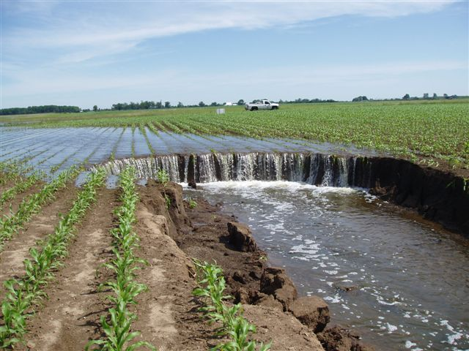
Conveying the science in difficult conversations (what I have learned)
Separate mitigation from adaptation – opportunity
for focusing agreement
Get in their space
- use local examples
(see extremes)
Engage stakeholders
early and often
Photo courtesy of RM Cruse
Notes:
Managing the unavoidable
Avoiding the unmanageable

Slide 7
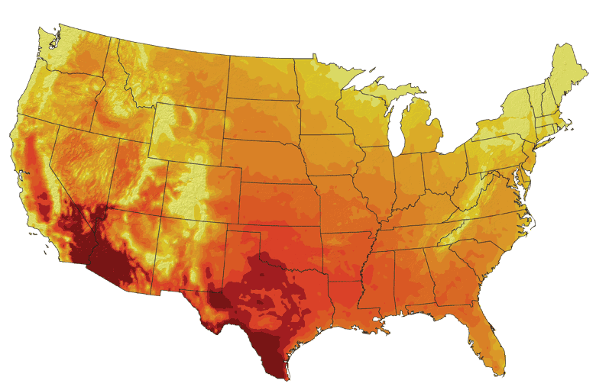
What to do about Extremes
Action on extremes is governed more by emotion and less by facts (my assertion)
Considered a good way to lose scientific credibility
Can’t accumulate/anticipate all possibilities (e.g., El Reno tornado, Hurricane Sandy, Arizona wildfire), so how to use examples?
Top priority for the US military
Average number of days over 100ºF
by 2100

Slide 8
Historical Example: Missed Opportunity
Impact of climate change on Iowa (Takle and Zhong, 1991):
Winters will warm more than summers
Nights will warm more than days
More precipitation in future climates
Shift in the seasonality of precipitation: more precipitation in spring and early summer, less in fall and winter

Slide 9
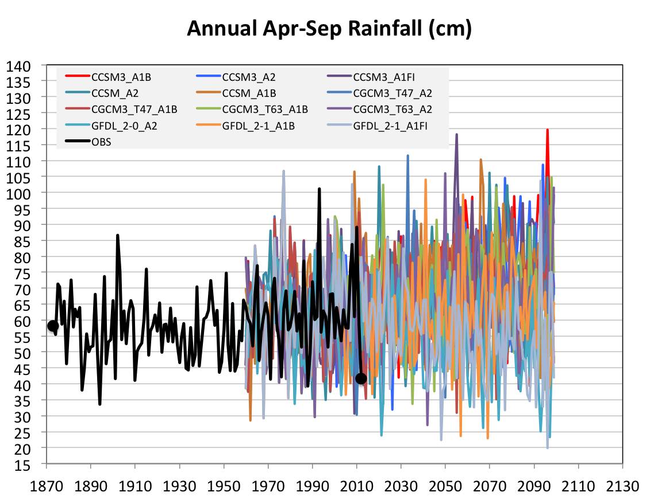
Future Variability in Growing Season Precipitation for Iowa
More intense rain events
Lines drawn by eye
More extreme droughts
CJ Anderson, ISU

Slide 10
Historical Example: Missed Opportunity
Impact of climate change on Iowa (Takle and Zhong, 1991):
Winters will warm more than summers
Nights will warm more than days
Increase in annual precipitation
Shift in the seasonality of precipitation: more in spring and early summer, less in fall and winter
Failed to engage stakeholder dialog on the impact of heavy spring rains

Slide 11
Difficult Conversations: Take-away Messages
Consistently rely on authoritative, best available science and don’t go beyond what the science will support
Communicate with stakeholders frequently in terms they understand and using local examples when available
Help and encourage stakeholders to ask good questions

